Slide 1

household power consumption report
Review and Benefits of Analysis

Slide 2
Agenda
Background
Summary statement
Historical Data
Seasonal Trends
Forecasting
Insights
Recommendations
Lessons Learned

Slide 3
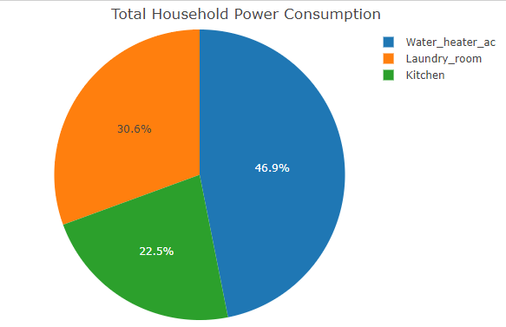
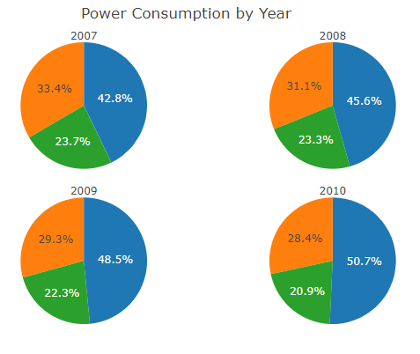
Background: Household Power consumption 2007-2010
In the time period of 2007 - 2010, people consumed the most power in the following areas of their home; Kitchen, Laundry Room and lastly the AC & Water Heater with the least amount consumed. Energy used by water heater and AC has increased every year from 2007-2010, whereas energy used by laundry room and kitchen has gradually decreased.

Slide 4
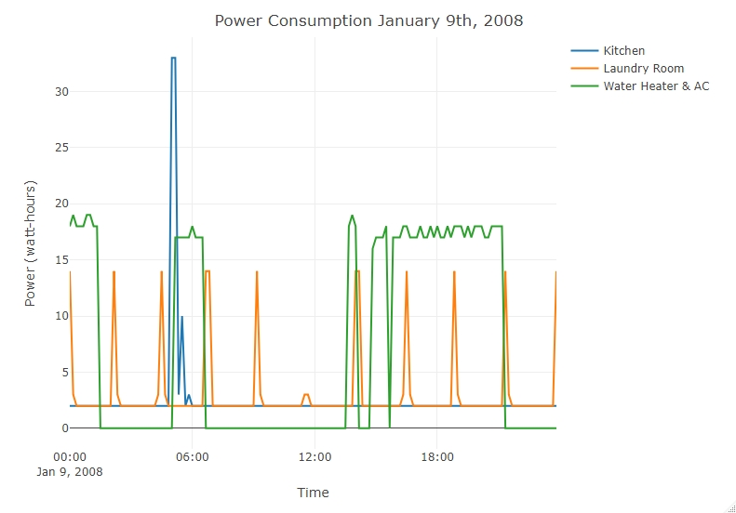
Historical Power consumption - daily
We randomly selected Jan 9th, 2008 for example.
The power consumption in the kitchen has a peak in the beginning of the day (home owners making breakfast) and remains very low for the rest of the day.
The power consumption of laundry room has regular intervals about every two hrs. This is likely due to the cycle of finishing and starting a new load of laundry.
Water heater & AC was used in the morning around 6am which would be when home owners are getting up and showering preparing to for work, and then between 2pm to 10pm which may coincide when children and parents are returning home.

Slide 5
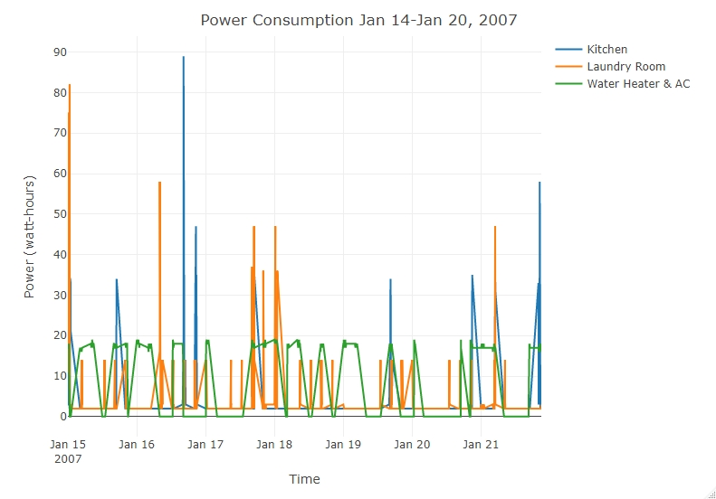
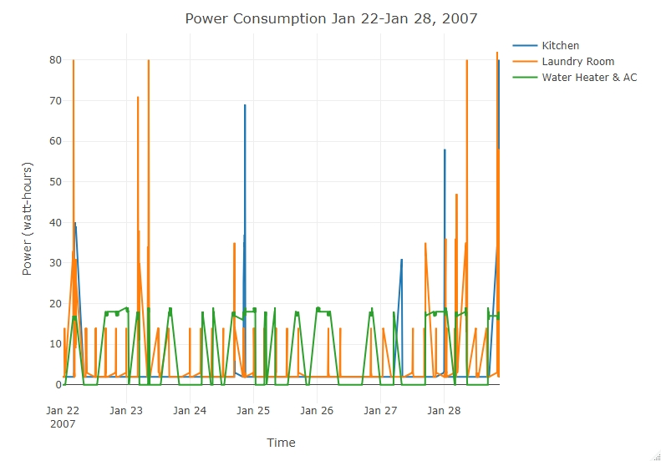
Historical Power consumption - weekly
In the time period of 2008 Jan 14-21, and 22 -28 (Mon. - Sun.), people consumed more power in the kitchen and laundry room on the weekend.
Kitchen power usage has peaks on Sunday night and in the middle of the week.
Laundry room usage has peaks on Sunday and beginning of the week.
Water heater & AC usage doesn’t have much variation during the week.

Slide 6
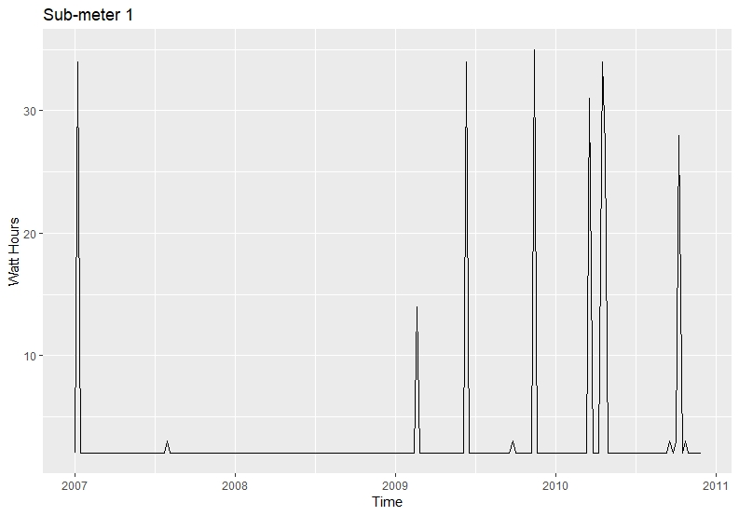
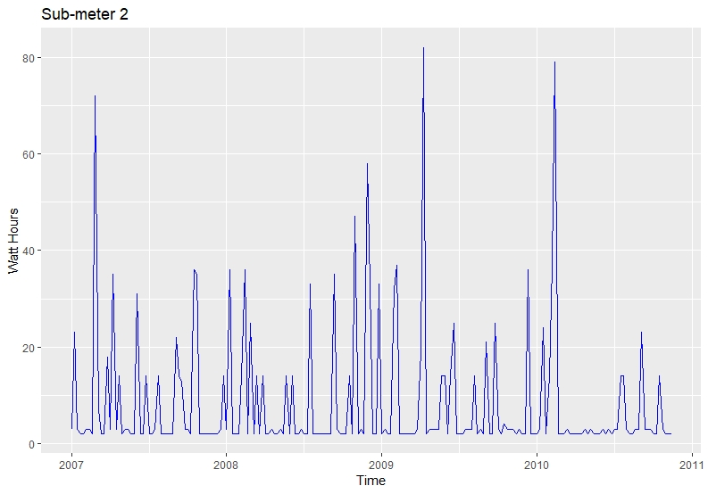
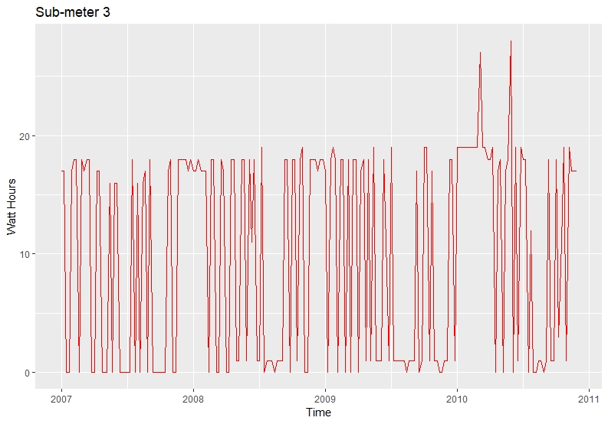
Historical Power consumption - (2007 – 2011)
Kitchen
Laundry Room
Water heater & AC
The power consumption of kitchen is much less frequent than laundry room and water heater /AC. But when the kitchen is in use it has a high peak.
The power consumption of laundry room has the most variation (usage fluctuates).
The power consumption of water heater /AC has the least variation but the most frequency.

Slide 7
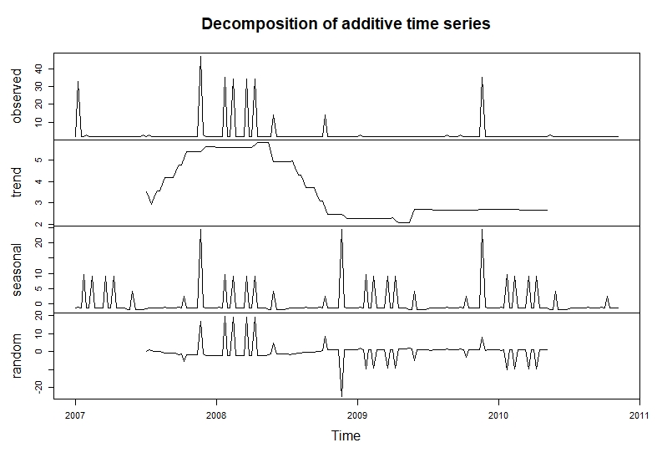
seasonal trend - Kitchen
The power consumption of Kitchen gradually increased since second half of 2007, reached peak in the beginning of 2008, and then started decreasing in the middle of 2008. It remained low ever since.
(Fact: 2008 was the launch of the National Energy Star Campaign directed at Consumers.)
We can see patterns in the seasonal trend: a spike near the end of each year, possibly because people cook more in holiday season. Also, people cook more in the winter than summer.
Kitchen

Slide 8
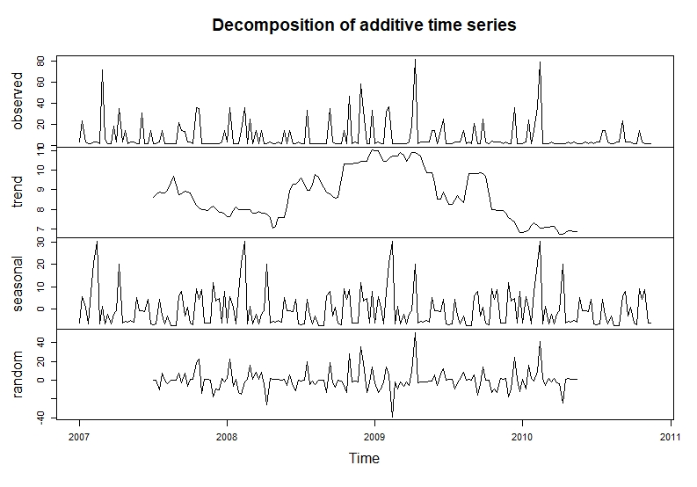
seasonal trend – Laundry Room
The power consumption of laundry room reached the highest point around the end of 2008 and the beginning of 2009 and then gradually decreased. since the second half of 2009.
As for seasonal trend, people use laundry room the most in the beginning of the year and during spring time.
Laundry Room

Slide 9
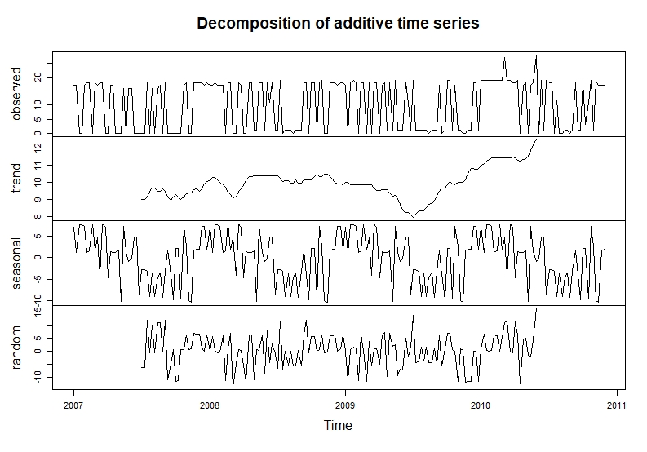
seasonal trend- water heater & ac
The usage of water heater & AC started decreasing in Spring 2009 and hit the lowest point in the middle of 2009. It has been constantly increasing since then.
The usage is always higher in the first half of the year than the second half of the year.
Water Heater & AC

Slide 10
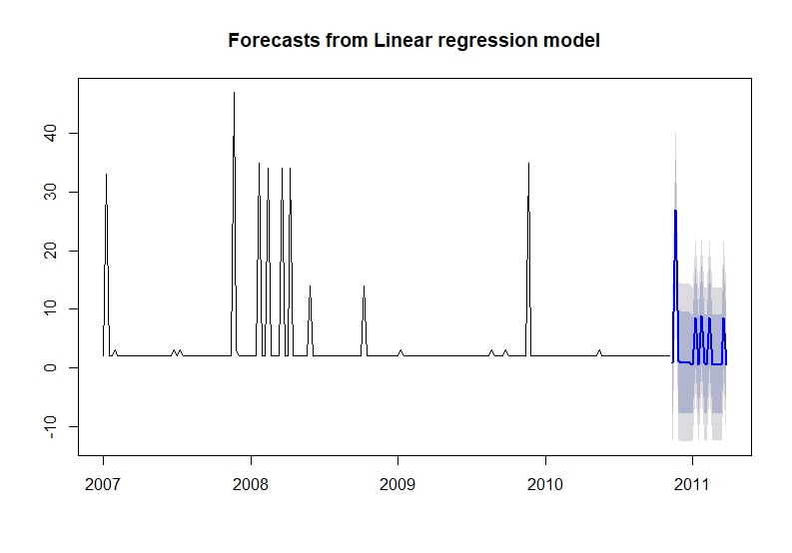
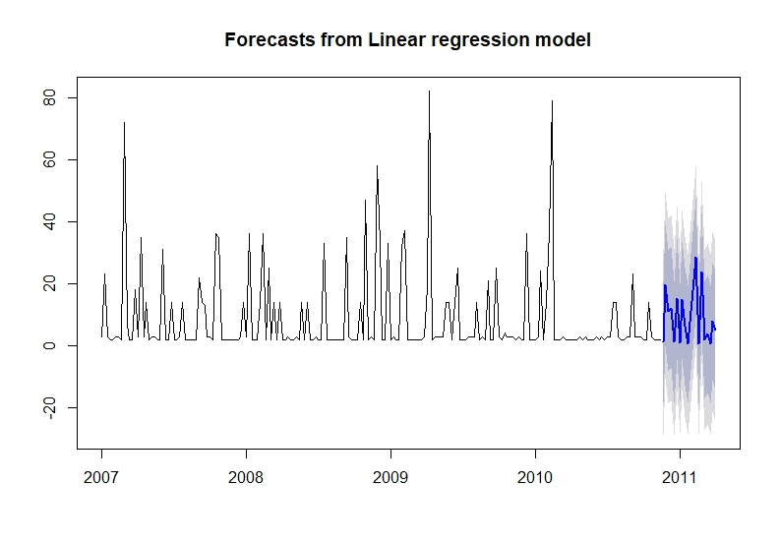
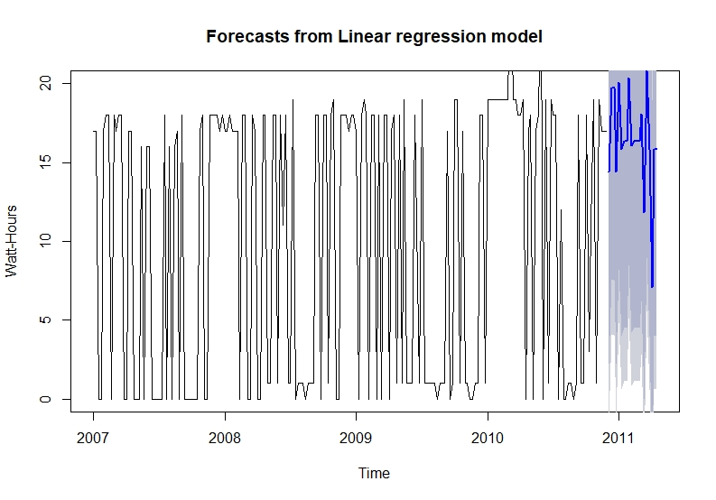
Forecasting: From Linear Regression models
Kitchen
Laundry Room
Water Heater & AC
The linear regression model on the left predicts that the power consumption of a Kitchen is much less frequent when compared to the Laundry Room, Water Heater & AC, also lower watt/per hour on average., which shows it has the lowest usage among the three.
The chart in the middle predicts the power consumption of a Laundry Room has the most variation between 0- 40 watt per hour, which has high and low usage periods.
The chart on the right the regression model shows us that the power consumption of a Water Heater & AC has the least variation ( between 5- 20 watt per hour) but the most frequency, showing a more constant usage.

Slide 11
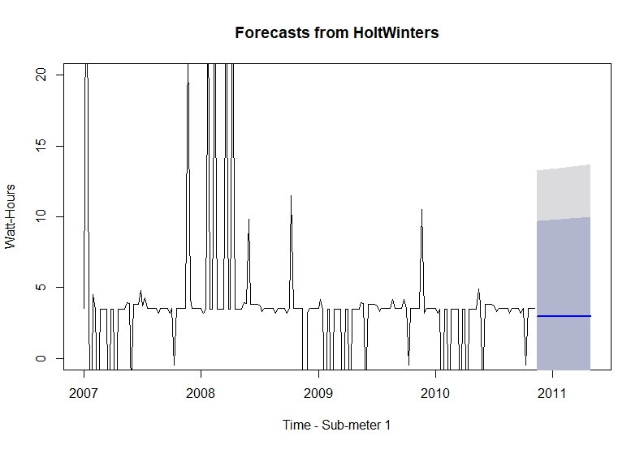
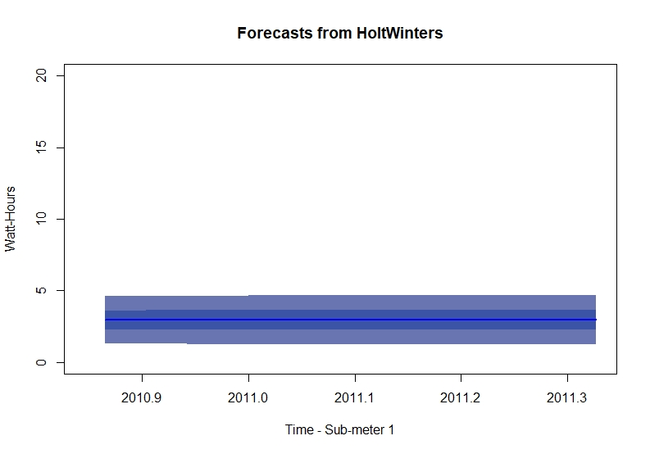
Forecasting: power consumption - kitchen

Slide 12
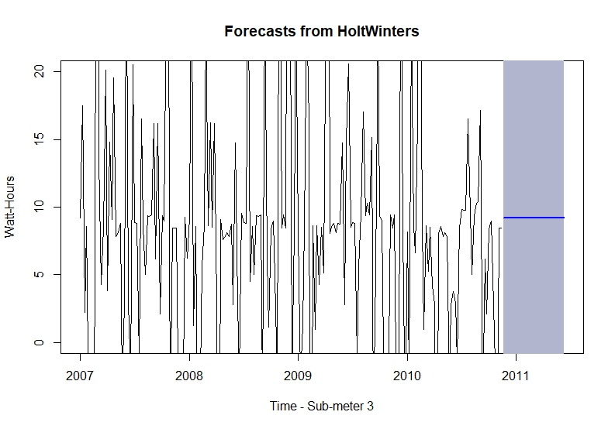
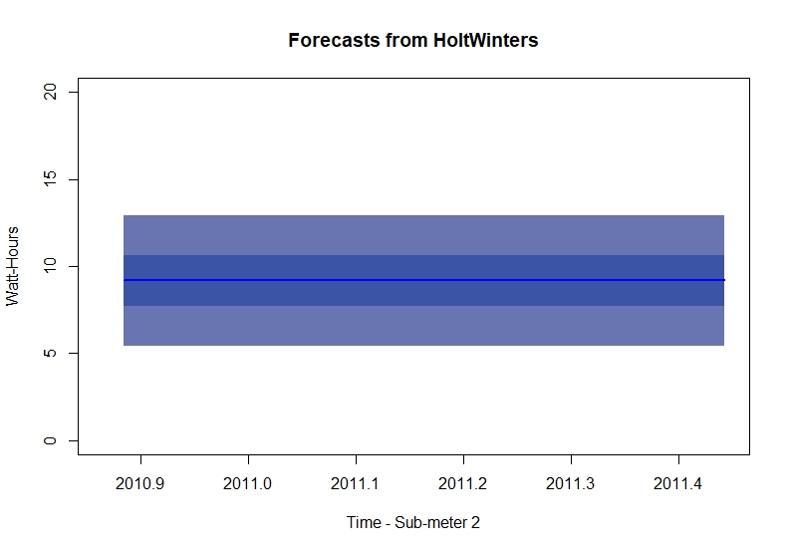
Forecasting: power consumption – laundry room

Slide 13
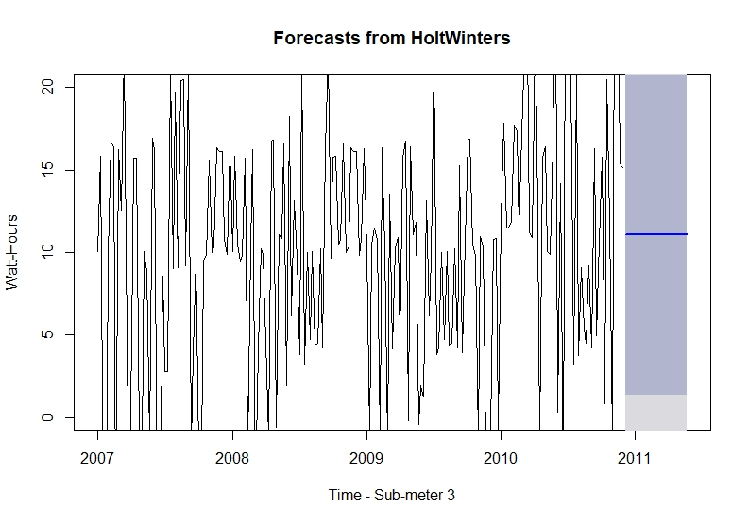
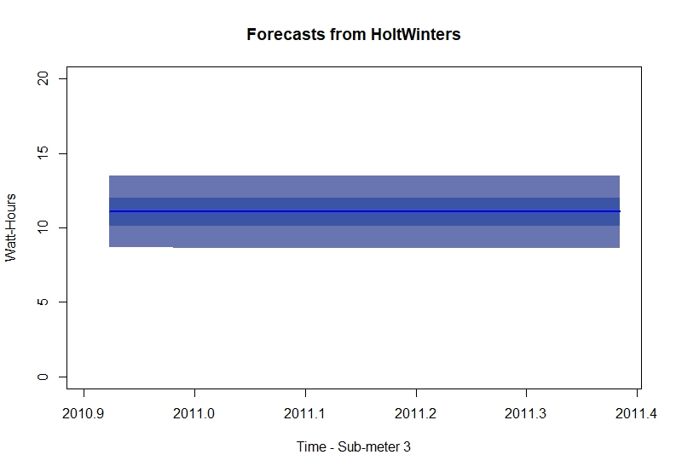
Forecasting: power consumption – water heater & ac
Forecast for all three sub-meterings appears to be a flat line, indicating the dataset is neither trended nor seasonal. How these amounts will fluctuate is not predictable based solely on the historic data. The expected range of the fluctuations is shown by the confidence limits.

Slide 14
Insights from analysis
Based on historical data, kitchen is not used frequently but when used it consumed a lot of energy. The forecasting shows an increase in frequency, lower watt/hour consumed.
Laundry Rooms usage have some variation in usage, but our forecasting shows no changes expected in usage but does indicate a lower watt/hour usage.
Water Heaters and AC have the highest frequency of use and forecasting does indicate a possible rise in watt/hour usage.
Home owner power consumption has been decreasing since mid 2008. This may coincide with the launch of the energy star campaigns directed at consumers in 2008.

Slide 15
Summary statement
Through this report we hope to provide you with confidence in our process and convince you that this project is relevant to your business needs.
The objective with this report will be to demonstrate the benefits of using sub-metering and IOT devices and how they can provide valuable data which will provide valuable information to home owners regarding their power consumption. As a builder you will be able to show home owners how these tools can assist them in seeing their current power consumption and then how they can make improvements to lower their power usage.
There is also the potential to expanded this information further in the future to include areas such as home lighting power consumption, home heating and water usage.

Slide 16

Recommendations
As one final point in this presentation we’d like to share our recommendations on what you as builders can market to your protentional home owner/buyers.
Kitchen:
Install appliances that have high efficiency and lower watt/hour usage.
Laundry Room:
High efficiency washer/dryer and perform larger loads with less frequency.
Sub-metering:
Devices should always be recommended/used as they provide detailed valuable data on power consumption.
AC:
Install smart thermostat, use scheduling to turn off when away from home.
Lighting:
Data analysis should include home lighting power consumption, to provide through usage reporting.
Water Heater:
Install on demand water heater to reduce constant usage.

Slide 17
Lessons learned
Produce time series plots
Use linear regression model to forecast seasonal time series
Decompose time series to correctly estimate the trend, and seasonal components.
Use exceptional smoothing to make forecasts

Slide 18

Thank You

